Slide 1
Chapter 2: The genetic code

Slide 2
Proteins
Proteins are key cellular components
The major classes of biomolecules that cells contain are DNA, lipids,
carbohydrates and proteins.
Proteins are the main functional components of a cell.
They can have many roles including:
Structural – e.g. scaffolding for the cell
Functional – e.g. enzymes carry out specific chemical reactions
The combination of proteins within a cell give it its characteristics
including shape and function.

Slide 3
Proteins
Enzymes
Enzymes are proteins that catalyse specific chemical reactions without
undergoing any change themselves.
Enzymes are involved in almost all cellular processes.
Catabolic enzymes degrade cellular components.
Anabolic enzymes build cellular components.

Slide 4
Proteins
Protein synthesis
The instructions for building proteins are contained in genes. Therefore,
the presence, abundance, structure and features of proteins are genetically
determined.
Proteins are essentially chains of amino acids in a specific sequence.
The sequence of amino acids in a protein is directly determined by the
sequence of nucleotides in the gene that encodes it.
DNA
Proteins
Cell’s
characteristics

Slide 5
Proteins
The genetic code
Three base pairs in a DNA sequence can form a codon.
One codon encodes one amino acid within a polypeptide chain.
There are 20 different amino acids that can be incorporated into a polypeptide.
DNA
codon
sequence
Protein
amino acid
sequence
Protein
structure
and features

Slide 6
Messenger RNA
Proteins
Chromosomes stay in the nucleus.
Protein synthesis occurs in the cytoplasm.
The messages for protein synthesis are carried from the nucleus to the cytoplasm by mRNA.

Slide 7
Messenger RNA
Proteins
Differences between RNA and DNA
RNA is ribonucleic acid. It contains ribose instead of deoxyribose.
RNA has adenine (A), guanine (G), cytosine (C)
and uracil (U), which pairs with adenine instead of thymine.
RNA is single stranded.
RNA is usually short (<4000 nucleotides).
DNA
codon
sequence
mRNA
codon
sequence
Protein
amino acid
sequence

Slide 8
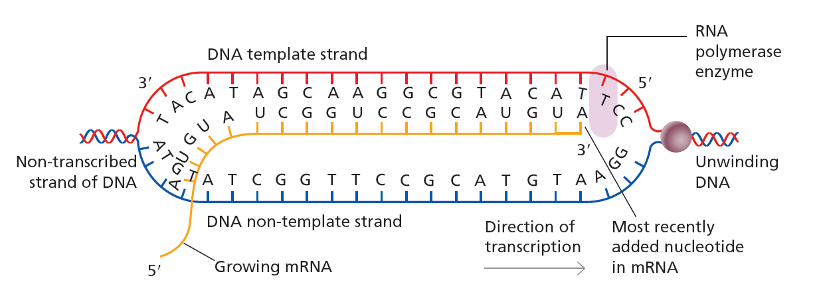
Transcription
Proteins
In transcription, DNA is unwound and the enzyme RNA polymerase moves
along the DNA making an RNA copy of the template strand of the gene.
Figure 2.2
Uracil is incorporated opposite adenine in the template strand.
RNA does not contain thymine.

Slide 9
Transcription
Proteins
Transcription starts at the gene promoter. In the promoter is the transcriptional
start site coded by the start codon ATG.
Transcription stops at a stop codon which can be TAA, TAG or TGA.
Following transcription, the new mRNA molecule is an exact copy of the DNA
template strand. It is called pre-mRNA and requires several processing steps
before it leaves the nucleus.
Transcription
Promoter
Gene
ATG
TGA

Slide 10
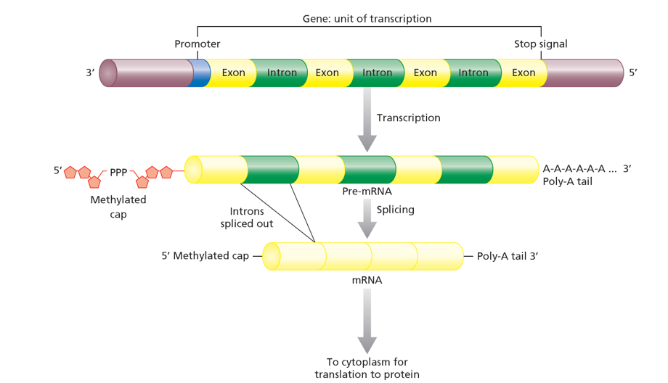
Splicing
Proteins
DNA contains introns within genes, which do not encode an amino acid sequence.
These are interspersed with exons, which form the amino acid coding
sequence of mRNA.
Introns are removed from pre-mRNA by splicing.
Figure 2.3
A poly-A tail is added at the 3’ (sugar) end of the mRNA.
A methyl cap is added at the 5’ (phosphate) end of the mRNA.

Slide 11
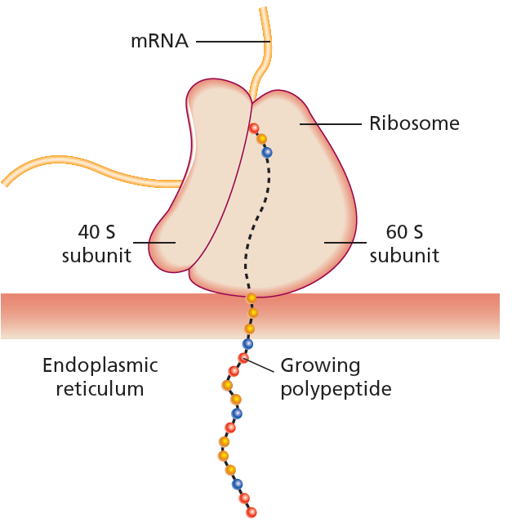
Translation
Proteins
In translation, the codons of mRNA are read
by a ribosome to form a polypeptide.
Ribosomes can be free in the cytoplasm or
associated with the endoplasmic reticulum,
feeding the nascent polypeptide into the ER
lumen.
In the ER the new peptide may undergo:
- corrections to its folding
- addition of functional groups (e.g. sugar groups)
- entry into the secretory pathway.
Figure 2.4

Slide 12
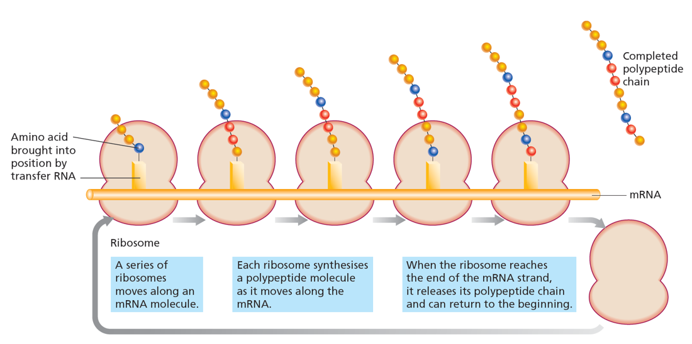
Polyribosome
Proteins
Multiple ribosomes can simultaneously work on translating a single mRNA.
This complex is a polyribosome and speeds up the rate of translation.
Figure 2.5

Slide 13
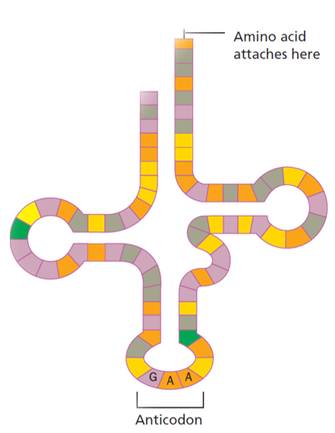
Transfer RNA
Proteins
Amino acids are delivered to the ribosome
by transfer RNAs (tRNAs).
These are RNA molecules that have anticodons.
Anticodons are complimentary to codons in mRNA.
Different tRNAs have different anticodons and
can carry different amino acids to ribosomes.
This is how the genetic code can specify the
amino acid sequence of a protein.
Figure 2.6

Slide 14
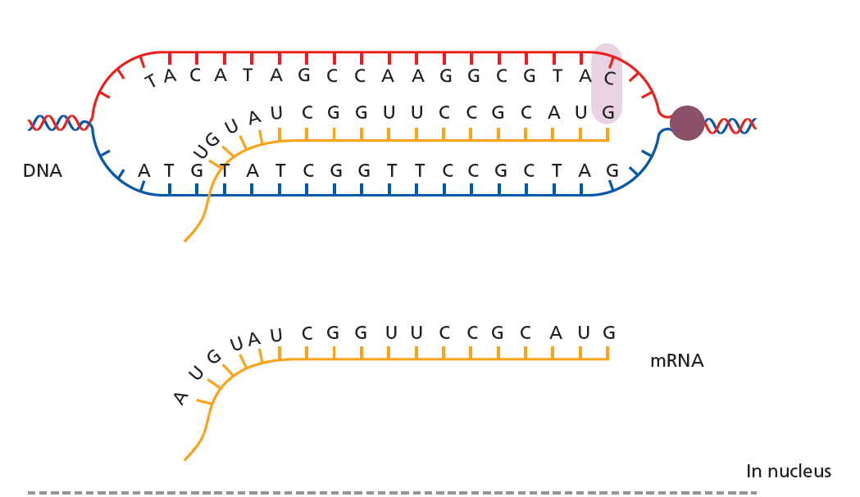
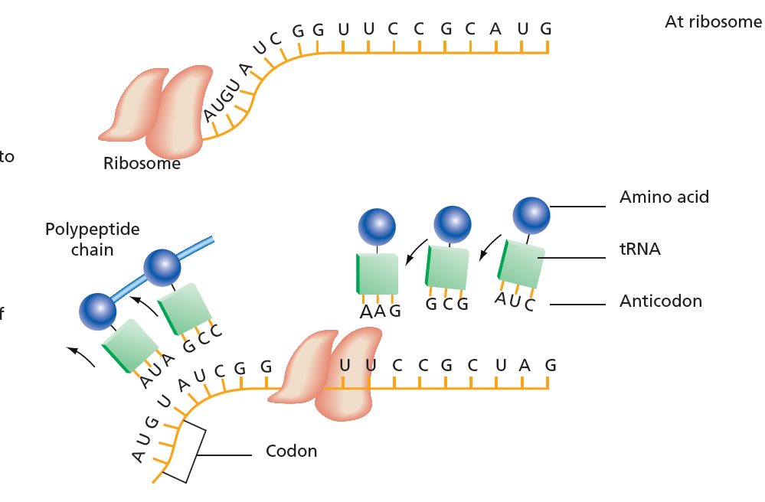
An overview of translation
Proteins
Transcription occurs
via RNA polymerase
in the nucleus.
Figure 2.7
mRNA is processed
before it leaves the
Nucleus.
In the cytoplasm a
ribosome attaches
to the mRNA.
Peptide bonds form
between adjacent
amino acids.
tRNAs bring amino
acids to the
ribosome-mRNA
Complex.

Slide 15
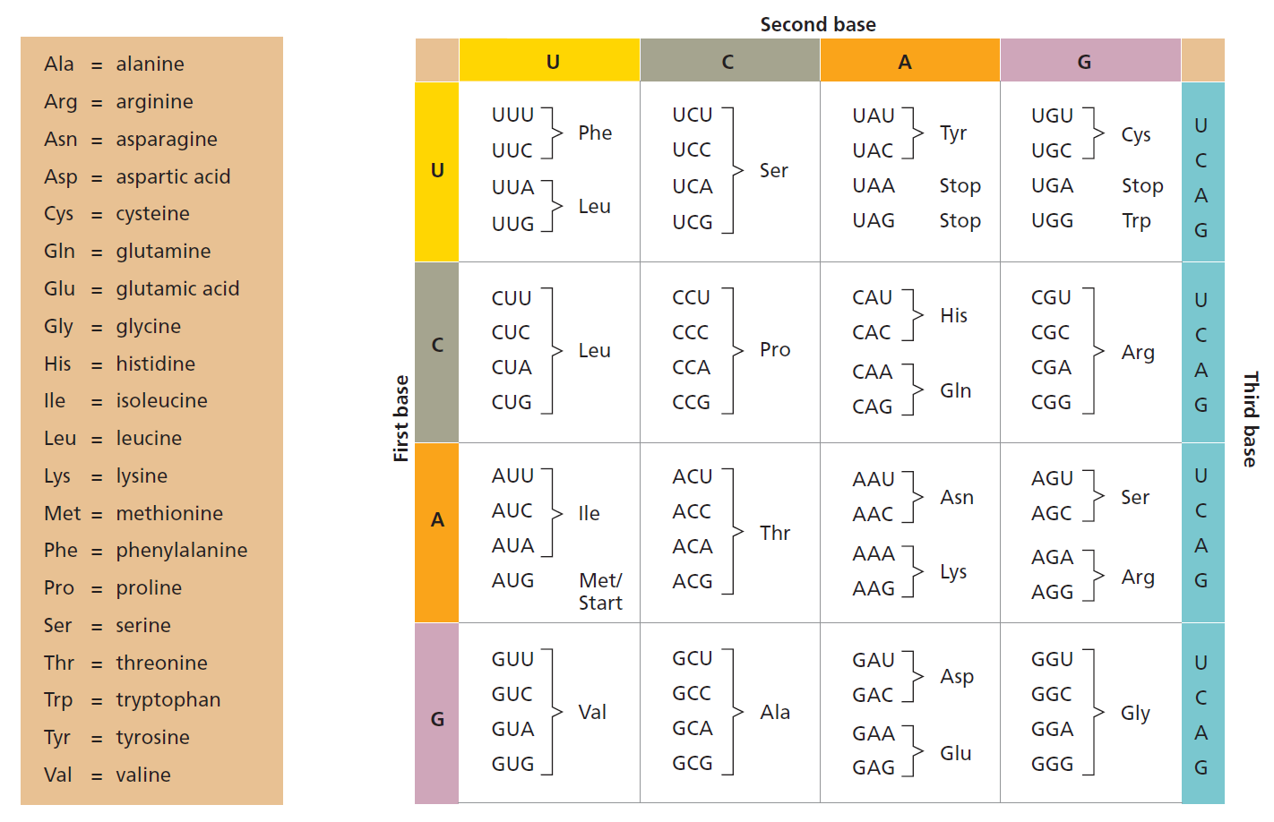
The universal genetic code
Proteins
Figure 2.8

Slide 16
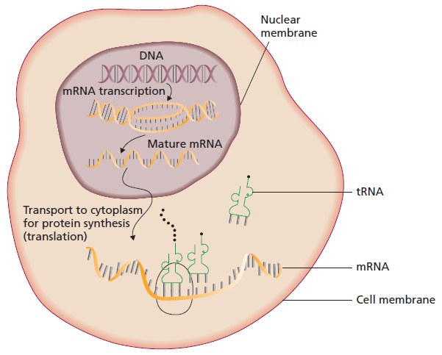
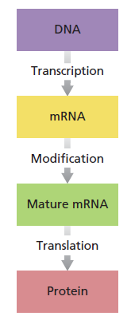
Overview: central dogma of molecular biology
Phenotypes
The set of proteins expressed in a cell determine its phenotype and that of the organism.
Figure 2.10

Slide 17
Exceptions to the central dogma
Phenotypes
New discoveries have shown the central dogma is not the only possibility.
Some retroviruses have an RNA genome from which they can reverse
transcribe DNA.
Most cases are more complex than
One gene – one mRNA – one protein.
A cell doesn’t express all of its genome at the same time.

Slide 18
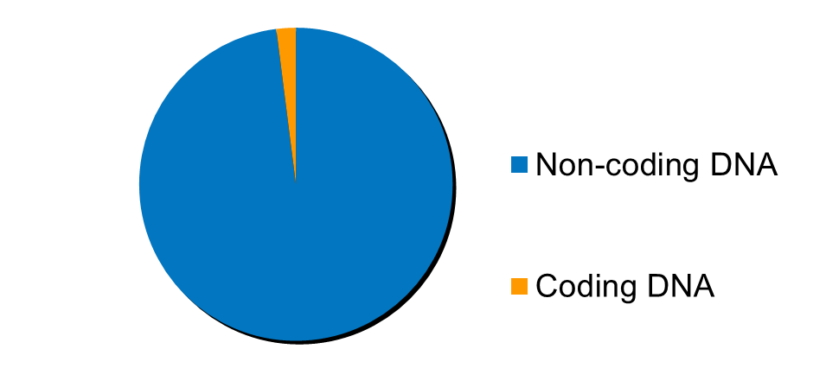
Coding and non-coding DNA
Phenotypes
Genes contain coding DNA. This is mainly in exons.
All the exons expressed in a cell are its exome.
The majority of DNA in humans, over 98%, is non-coding, i.e. it does
not encode proteins.

Slide 19
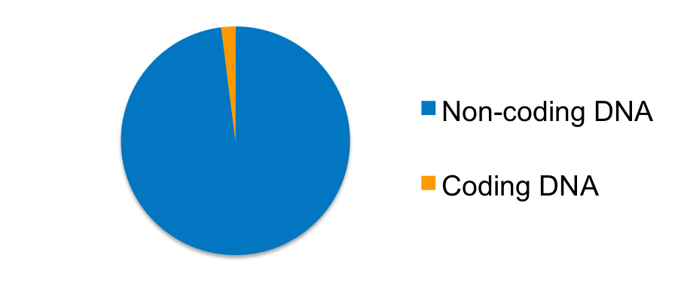
Coding and non-coding DNA
Phenotypes
Coding DNA
Encodes proteins
Includes exons
Forms the cell’s exome
Encodes the cell’s proteome
Non-coding DNA
Does not encode proteins
Includes genes that encode ribosomal RNA (rRNA), tRNA and other regulatory RNAs
Contains regulatory DNA sequences
Contains an accumulation of probably unused DNA (‘junk’)
Much of its function is still unknown.

Slide 20
Gene regulation: DNA accessibility determined by epigenetics
Phenotypes
Epigenetics: ‘outside of genetics’
A means of regulating gene expression that is not genetically encoded, i.e. not determined by the DNA sequence.
Epigenetics can be influenced by developmental cues, environmental factors and other signals a cell receives.
Epigenetic modifications mainly affect chromatin structure and are stable during mitosis and meiosis, i.e. they are heritable.

Slide 21
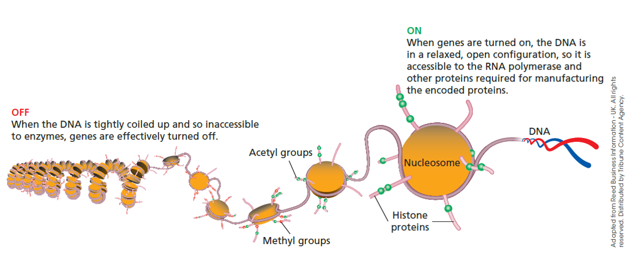
Gene regulation: DNA accessibility determined by epigenetics
Phenotypes
Figure 2.11
Chromatin can be condensed and inaccessible, preventing DNA transcription machinery from getting to genes.
Chromatin can be loose and nucleosomes spaced apart, allowing transcription machinery to access and transcribe DNA.

Slide 22
Gene regulation: Epigenetics
Phenotypes
Methylation:
adds positive charge to histones
Acteylation:
adds negative charge to histones
Histones:
positively
charged
Chromatin condensed
Transcription off
DNA:
negatively
charged
Chromatin open
Transcription possible

Slide 23
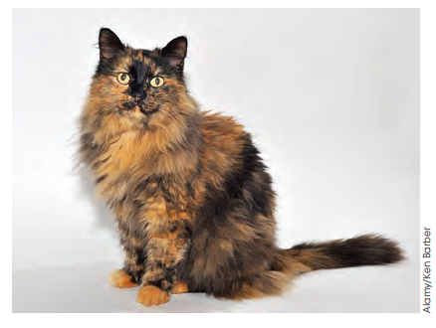
Two examples of epigenetics
Phenotypes
X-inactivation
One of the two X chromosomes in females is silenced by methylation to avoid excessive expression of X-linked genes (e.g coat colour in cats).
Imprinting
One copy of a gene may be silenced by methylation to avoid over-dosing of the gene product.
Figure 2.12

Slide 24
Gene regulation by regulatory proteins
Phenotypes
Genes have promoters. These determine when and where they are expressed.
Transcription
Promoter
Enhancer
Gene
Promoters contain binding sites for transcription factors (TFs), which can recruit or block RNA polymerase (and are thus activators or repressors).
TFs are one of the mains way of regulating expression of a gene or group of genes. They can work individually or in groups.
TFs can bind to enhancers, regulatory regions that may be outside the gene and which boost gene expression.

Slide 25
Gene regulation by microRNAs
Phenotypes
MicroRNAs (miRNAs) have sequences that are complimentary to mRNAs.
Binding of miRNAs to mRNAs inhibits their translation and usually leads to
mRNA destruction.
miRNAs are encoded by genes and are themselves transcriptionally
regulated (promoters, enhancers, transcription factors).

Slide 26
Gene transcription in prokaryotes
Phenotypes
Most prokaryotes do not carry ‘junk’ DNA – their genomes are concise.
Prokaryotic environments are variable and gene transcription can be tailored accordingly.
An operon is a cluster of genes required for the same purpose that are transcribed on a single mRNA strand. They have the same promoter and are regulated together.
Examples:
The lac operon encodes enzymes that metabolise lactose when it is present in the environment.
The trp operon inhibits the expression of enzymes that synthesise tryptophan when it is present in the environment.

Slide 27
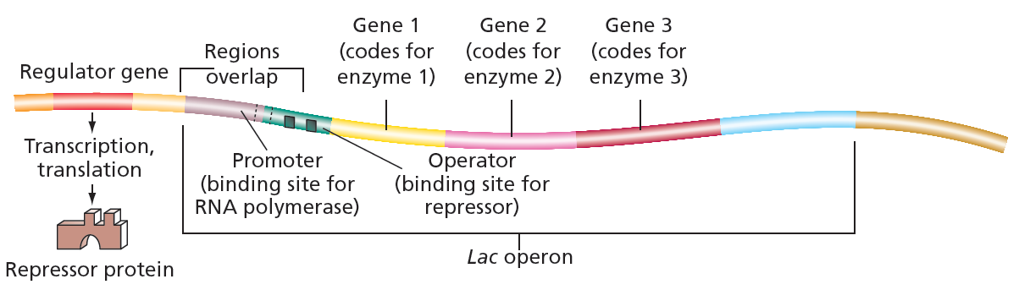
The lac operon
Phenotypes
When the environment of E. coli bacteria contains lactose, they can switch on a set of genes that allows them to use lactose for cellular metabolism.
This set of genes is called the lac operon. It contains the genes for β-galactosidase, β-galactosidase permease and β-galactosidase transacetylase.
Figure 2.14

Slide 28
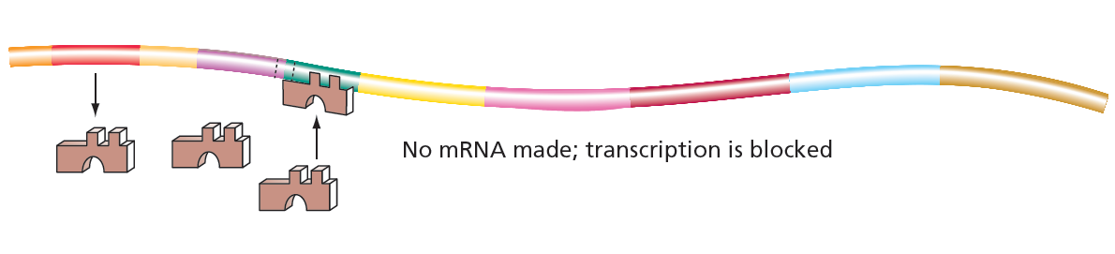
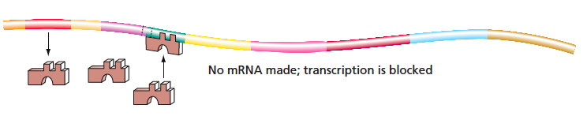
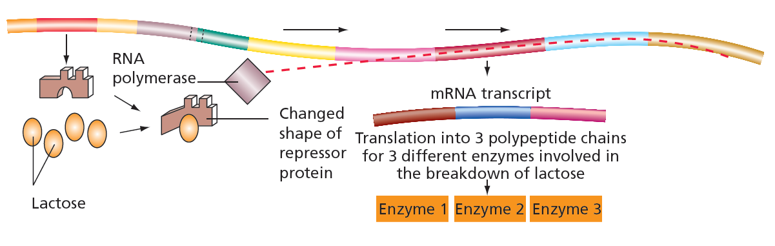
The lac operon
Phenotypes
No lactose:
The repressor binds the promoter and inhibits RNA polymerase access.
Lactose present: Lactose binds the repressor and changes its shape, stopping it from binding to the promoter.
Figure 2.14

Slide 29
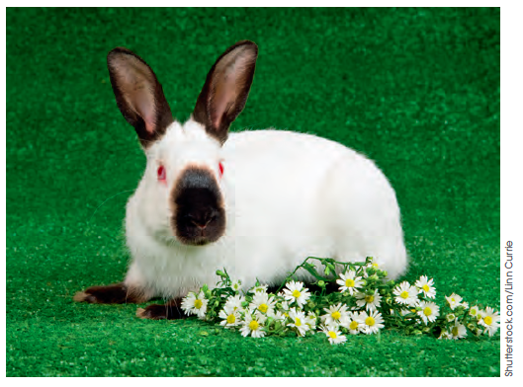
Gene expression is often environmentally influenced
Phenotypes
As well as the prokaryotic gene regulation examples, a very large number of cases of environmental influences on gene expression exist across all kingdoms.
In this image, a Himalayan rabbit expresses a protein for dark pigment in its outer (colder) extremities.
The dark pigment absorbs light to warm these cold spots.
Figure 2.15

Slide 30
Gene expression is often environmentally influenced
Phenotypes
Environmental factors can also regulate gene expression at an epigenetic level.
Research into this topic is in its infancy, but it is clear that a range of environmental factors can affect gene expression, including:
diet
environmental contaminants
temperature
behaviour.

